Slide 1

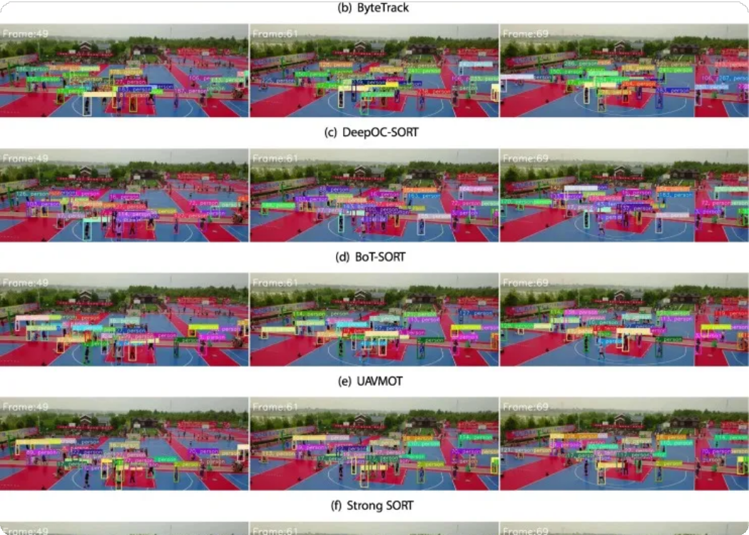



Multi-Camera Tracking System
Aerial Multi-Object &
YOLOv8 + DeepSORT + Kalman + PID + Distance Estimation
+ Multi-Camera Fusion
Real-time Vision System for Aerial Robotics & Autonomous Tracking
Multi-Camera
Real-time Tracking
AI-Powered

Slide 2





Real-time Detection & Tracking
Advanced object detection and tracking system operating in real-time
Multi-Object & Multi-Camera Support
Simultaneously tracks multiple objects across multiple camera streams
Project
Overview
Aerial Robotics Ready
Designed for drone follow-me systems and robot vision research
Intelligent Recovery
Auto-recenter and auto-relock capabilities for robust tracking
Comprehensive Analytics
Distance, velocity, angle measurements with CSV logs and graphs

Slide 3










Technical Architecture
Multi-Camera Inputs
YOLOv8 Detection
DeepSORT Tracking
Kalman Filter
PID Gimbal Align
Distance & Velocity
CSV Logger
Graph Generator
Multi-Cam Fusion
Homography Projection

Slide 4

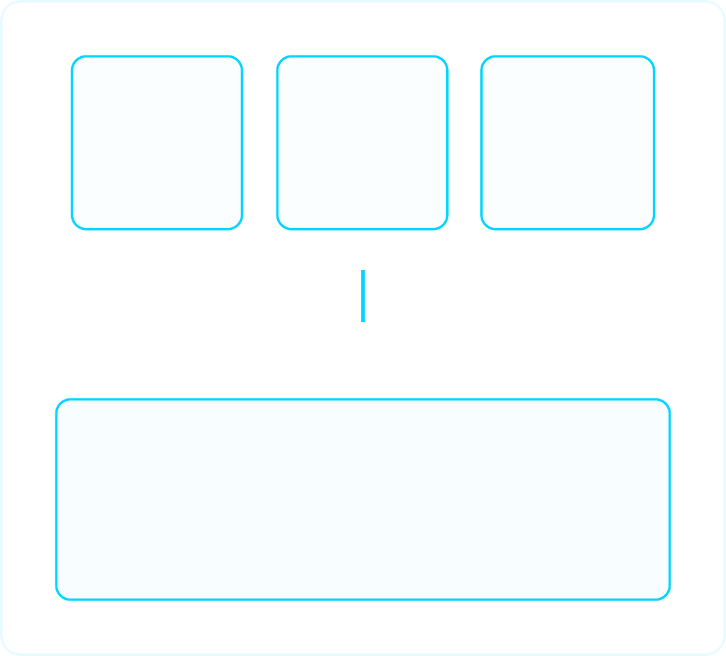



Multi-Camera Fusion
Fusion Process
Camera 1
H₁ Matrix
Camera 2
H₂ Matrix
Camera N
Hₙ Matrix
Each camera has a 3×3 homography mapping image → world plane
All detections projected into a single global space
DeepSORT runs globally → unified track IDs
Benefits
Unified Global Space
DeepSORT + Unified Track IDs
Larger effective FOV
Fewer blind spots
Better continuity
Robust tracking

Slide 5

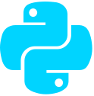






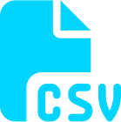

Tech Stack
Python 3.10
YOLOv8
(Ultralytics)
DeepSORT
ReID Tracking
OpenCV
Video I/O, Tracking
NumPy
Calculations
Matplotlib
Graph Generation
Homography
Multi-Camera Fusion
CSV Logging
+ Analytics
Modular Architecture
Easy to extend for drones, ROS, or MAVSDK

Slide 6
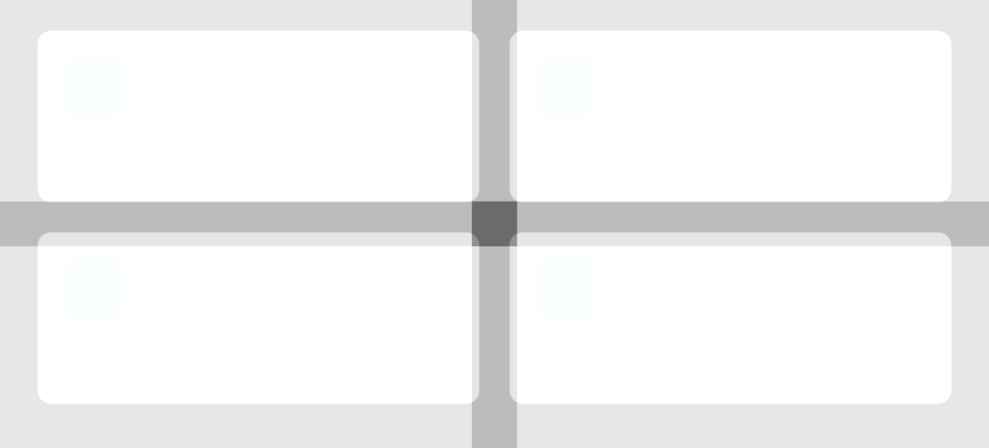

Challenges & Problems Faced
Integrating YOLO, DeepSORT, Kalman, PID
Complex integration of multiple algorithms and ensuring seamless data flow between components
Ensuring Real-Time Performance
Optimizing computational efficiency to maintain high frame rates for aerial tracking applications
Handling Occlusions & ID Switching
Maintaining consistent object IDs when targets are temporarily occluded or cross paths
Implementing Auto-Recenter & Auto-Relock
Developing robust mechanisms to automatically recenter and relock on targets during dynamic movements

Slide 7













Advantages & Use Cases
Advantages
Use Cases
Highly modular & scalable
Tracks multiple objects across multiple cameras Smooth tracking even with occlusions
Real-world metrics: distance, velocity, angle Global tracking IDs across cameras
Ideal for robotics experiments
Autonomous drones (follow-me, surveillance)
Multi-camera security systems Aerial robotics research
Traffic tracking (vehicles, pedestrians) Sports analytics with multiple camera views

Slide 8
Thank You
Aerial Multi-Object & Multi-Camera Tracking System

